Slide 1
Let’s Make a Movie!
FEATURING THE GROUP 6 CINEPHILES:
DENNIS BETT, LEONARD FORRESTER, STEVEN FRASICA,
KEVIN MILLER, JEFF OLIVER, AND RAKESH RODDA

Slide 2
PREMISE
HOWEVER!
WE ARE ENTERPRISING MOVIE ENTHUSIASTS WHO WANT TO MAKE OUR OWN MOVIE!
WE ARE BROKE STUDENTS STUDYING AI DEVELOPMENT… *NOT* CINEMATOGRAPHY!
USING DATA ANALYSIS, CAN WE PREDICT WHAT TYPE OF MOVIE WE SHOULD PRODUCE ON OUR LIMITED BUDGET TO MAXIMIZE OUR PROFIT?
Notes:
Can read slide essentially

Slide 3
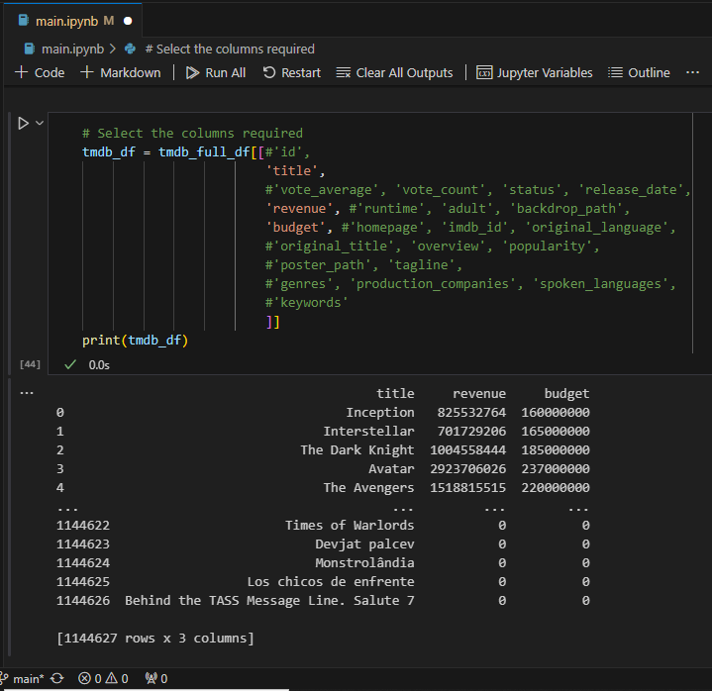
OUR DATASET
USING THE “FULL TMDB MOVIES DATASET 2024” (HTTPS://WWW.KAGGLE.COM/DATASETS/ASANICZKA/TMDB-MOVIES-DATASET-2023-930K-MOVIES), WE WERE ABLE TO ANALYZE OVER A MILLION MOVIES BY GENRE, REVENUE, IMDB RATING, AND OTHER METRICS!
SHRUNK DATA TO ONLY INCLUDE 2013-2023 MOVIES
ALSO REMOVED INCOMPLETE DATA TO BETTER ANALYZE OUR DATAFRAME
NOTICE THE TOTAL RESULTS ------------------->
Notes:
Can read slide
Note that even after all of these filters, we still had thousands of movies to use

Slide 4
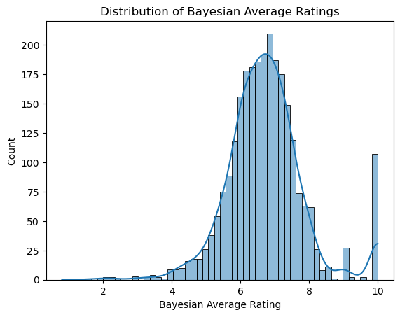
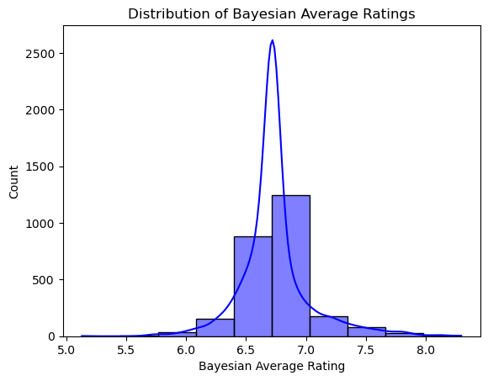
MOVIE RATINGS DISTRIBUTION
AVERAGE MOVIE RATING BY FANS
WE NEED TO IGNORE OUTLIERS WITH MINIMAL VOTES
Notes:
Before going into data, we can already see the highest rated movies
Note the large number of perfect 10’s, can describe the axes here
Need to filter out anything with minimal votes, which leads to Bayesian analysis
Considering two factors: vote count and vote average
We can analyze the highest voted movies and determine the average score
IMDB rating -> bayesian IMDB rating -> top 10 movies w/ highest scores
removing uncertainty and extreme values

Slide 5
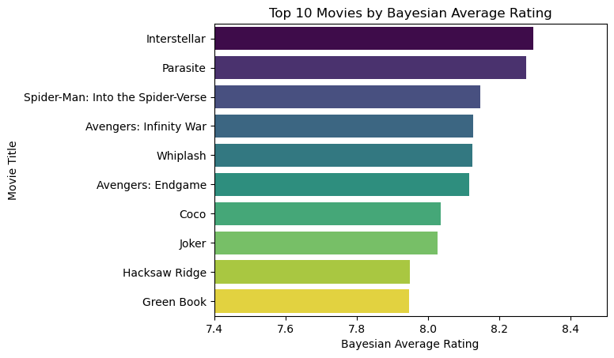
Notes:
While likely a contentious list, these are all critically acclaimed movies and could very feasibly be a top 10 list

Slide 6
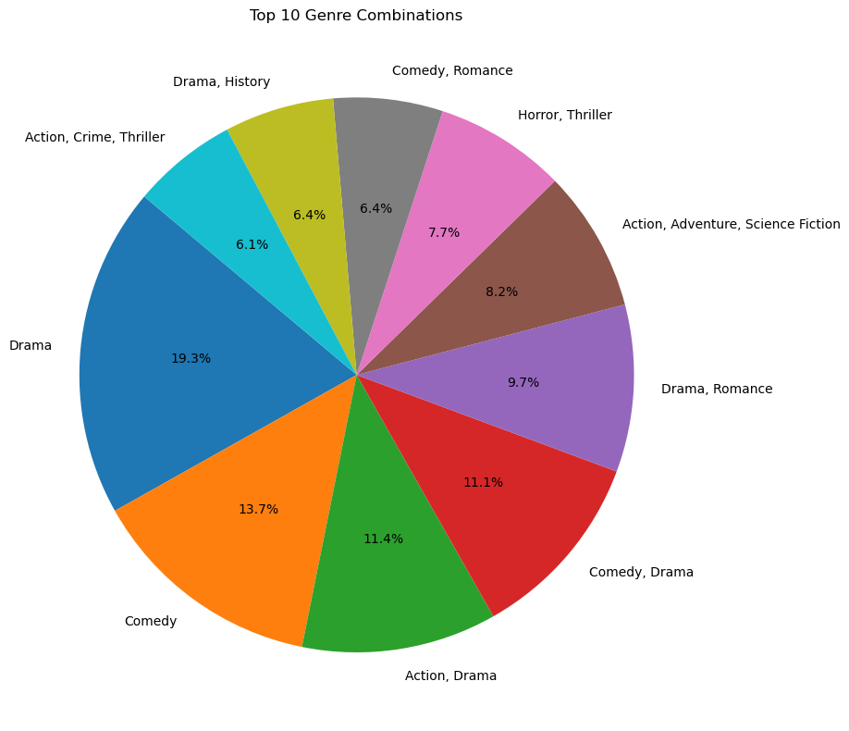
MOST FREQUENT GENRE COMBINATIONS
DRAMAS ARE THE MOST COMMON UNIQUE GENRE
DRAMA AND ACTION IS THE MOST COMMON COMBINATION
Notes:
We can also search for the most frequent genres and genre combinations
Note that this is before we split the genres and thus an action/drama movie would not be included in a search for drama
This presents the problem of how to search *all* drama movies, including ones with other genres

Slide 7

SORTING GENRES
MOST MOVIES CAN BE IN MULTIPLE GENRES SIMULTANEOUSLY
THIS WAS ORIGINALLY READ AS A SINGLE STRING AND WAS DIFFICULT TO SEARCH
WE HAVE TO FIRST SPLIT THE STRINGS IN THE GENRE CATEGORY IN ORDER TO FILTER AND SEARCH BY GENRE
Notes:
We can split the strings for each movie’s genre result to be read as individual keywords that can then be parsed individually rather than as a group when searching.
For example, “Interstellar” is classified as action, sci-fi, and adventure, which originally can only be searched for as a group

Slide 8
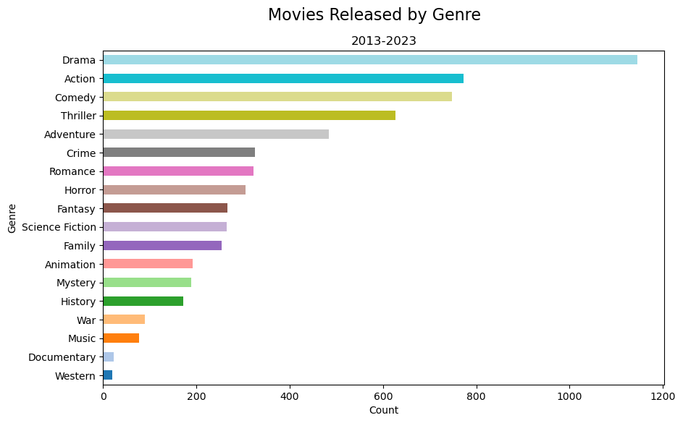
DRAMA IS THE MOST PRODUCED GENRE OVERALL
Notes:
Can read slide

Slide 9
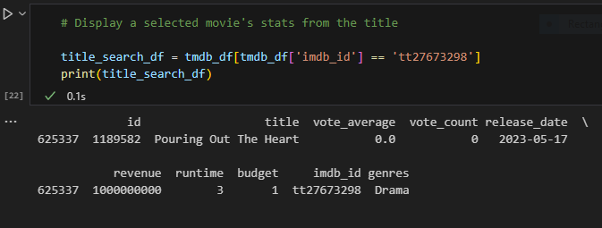
OUR NEXT STEPS
AFTER SORTING BY GENRE, WE CAN THEN SORT BY REVENUE AND PRODUCTION COST TO DETERMINE A RETURN-ON-INVESTMENT (ROI)
THIS CAN BE APPLIED TO ENTIRE GENRES TO ANSWER OUR PRIMARY QUESTION ABOUT PROFITABILITY
WE HAD TO FILTER OUT MORE OUTLIERS LIKE “POURING OUT THE HEART”
Notes:
We are trying to answer what is each genre’s Return-On-Investment (ROI)
Note that similar to the bayesian analysis for movie rating, we also had to filter out results with minimal budgets or revenues

Slide 10
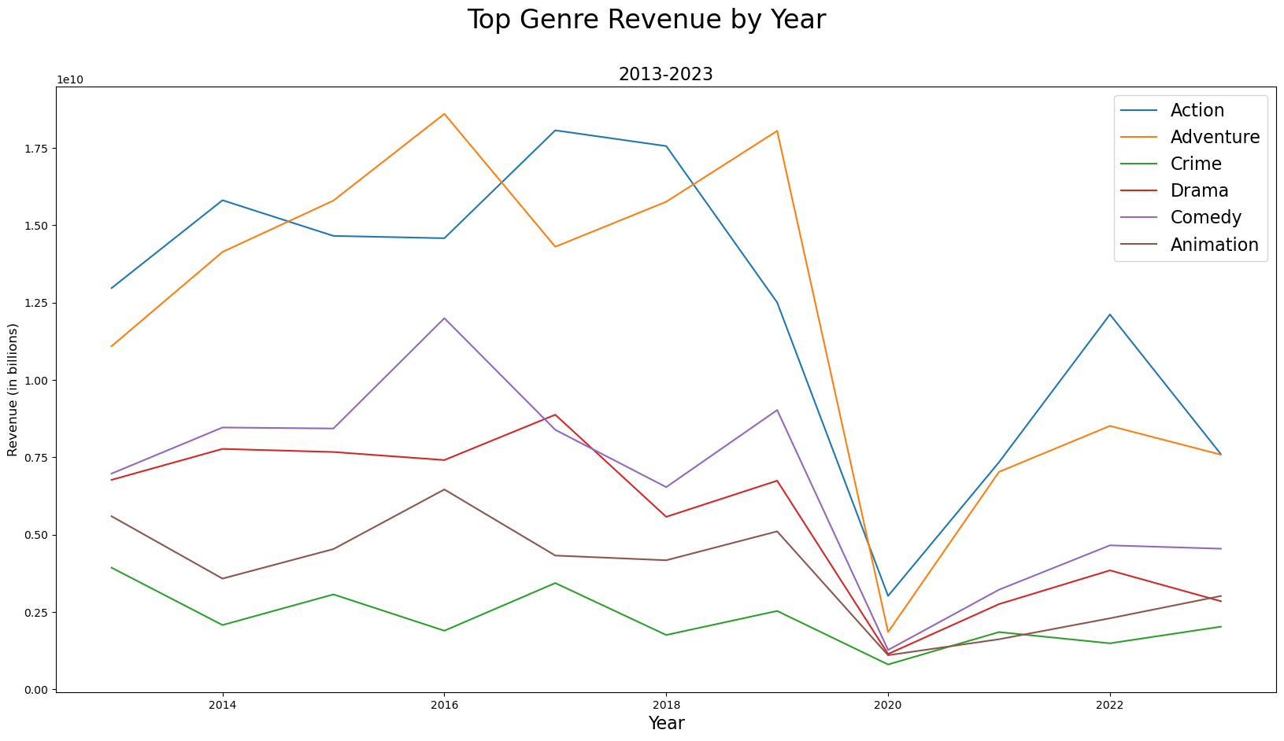
ACTION AND ADVENTURE HAD THE HIGHEST TOTAL REVENUES
Notes:
In order to make the graph more readable, we used the top 6 results
Comment on the 2020 drop and lack of rebound from most genres

Slide 11
AND THE MOMENT YOU’VE ALL BEEN WAITING FOR
THE GENRE WITH THE GREATEST ROI ON AVERAGE IS…

Slide 12
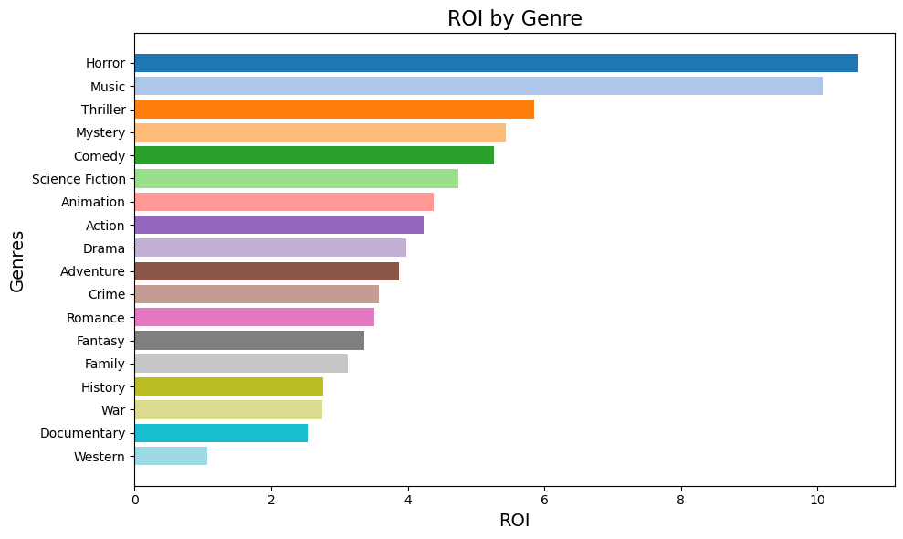
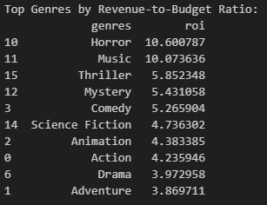
HORROR
Notes:
Should note the top ROI’s, as well as the low production cost of horror movies relative to others

Slide 13
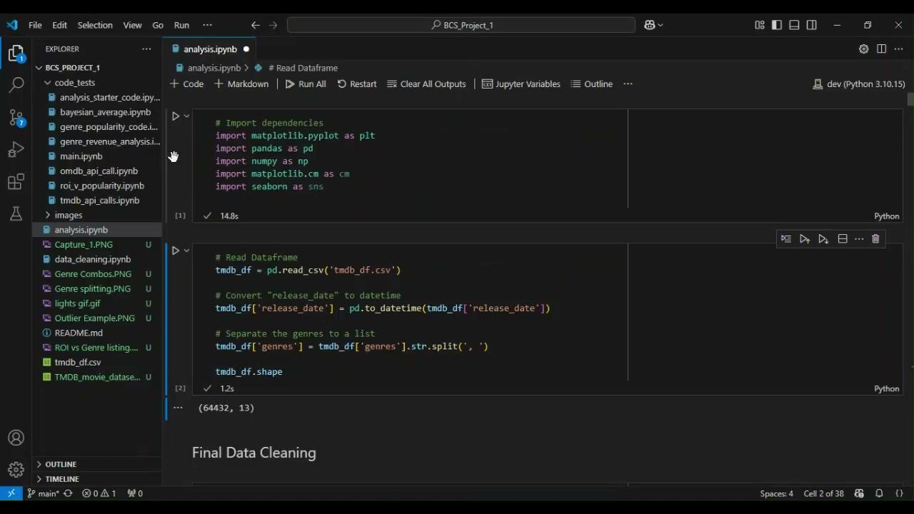
DEMO
Notes:
Very quick demonstration of our project where we sort our data into genres, convert to date-time, and then finally the results!

Slide 14
IMPORTANT NOTES FOR OTHER DIRECTORS!
WHILE OUR PROJECT IS ILLUMINATING, THERE ARE SOME AREAS OF CONCERN!
WE ARE ONLY USING ONE DATABASE, WHICH CAN BE PROBLEMATIC
THE DATABASE IS *LARGE* (OVER 1.1 MILLION DIFFERENT MOVIES) AND COMPUTERS WERE NEARLY FRIED IN OUR RESEARCH!
MANY RESULTS ARE MISSING DATA, AND WERE DROPPED FROM OUR ANALYSIS
MOVIES CAN HAVE MULTIPLE GENRES, MAKING ANALYSIS SIGNIFICANTLY MORE DIFFICULT
SOME MOVIES SHARE THE SAME TITLE AND MUST BE DIFFERENTIATED FROM EACH OTHER
GENRE METRICS ARE NOT NECESSARILY INDICATIVE OF AN INDIVIDUAL MOVIE’S SUCCESS
Notes:
As previously stated, string splitting and shrinking our data size to remove bad data were the largest parts of our project, but we also had some other problems like multiple movies with the same titles and genre data is very much not indicative of an individual movie

Slide 15
FUTURE POSSIBILITIES
THE ENTIRE DATASET
LOCATIONS, ACTORS, PRODUCTION COMPANIES AND OTHER FACTORS
OTHER FORMS OF ENTERTAINMENT (EX. - SHOWS)
WHERE ELSE COULD WE GO WITH OUR RESEARCH?
Notes:
Can say the “future blockbuster” slide here instead of displaying the next one entirely before the fun reveal at end

Slide 16
OUR FUTURE BLOCKBUSTER
“Sure to rival the blockbuster greats like ‘Pouring Out the Heart’.”
-Movies Insider
COMING SOON TO A THEATER NEAR YOU
INSPIRED BY THE MOST SUCCESSFUL AND BELOVED MOVIES OF THE LAST DECADE…
“Wow! Take ALL my money!”
-Anonymous
“I can’t believe this is an actual movie???”
-NY Times
“Awe-inspiring. 1,144,627 out of 10.”
-My neighbor Bob

Slide 17

THANK YOU!
INTERSTELLAR PARASITES:
INTO THE SPIDERVERSE:
THE HORROR MUSICAL
WE CAN’T WAIT TO SEE YOU AT OUR FUTURE RED CARPET DEBUT!

Slide 18
QUESTIONS?

